Slide 1
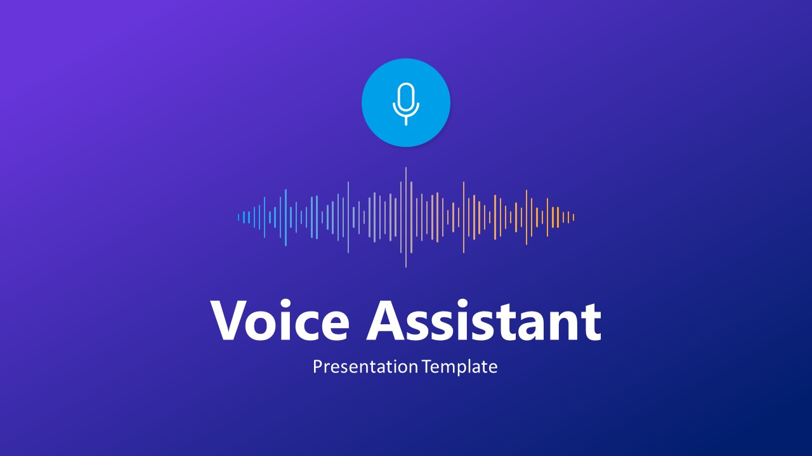
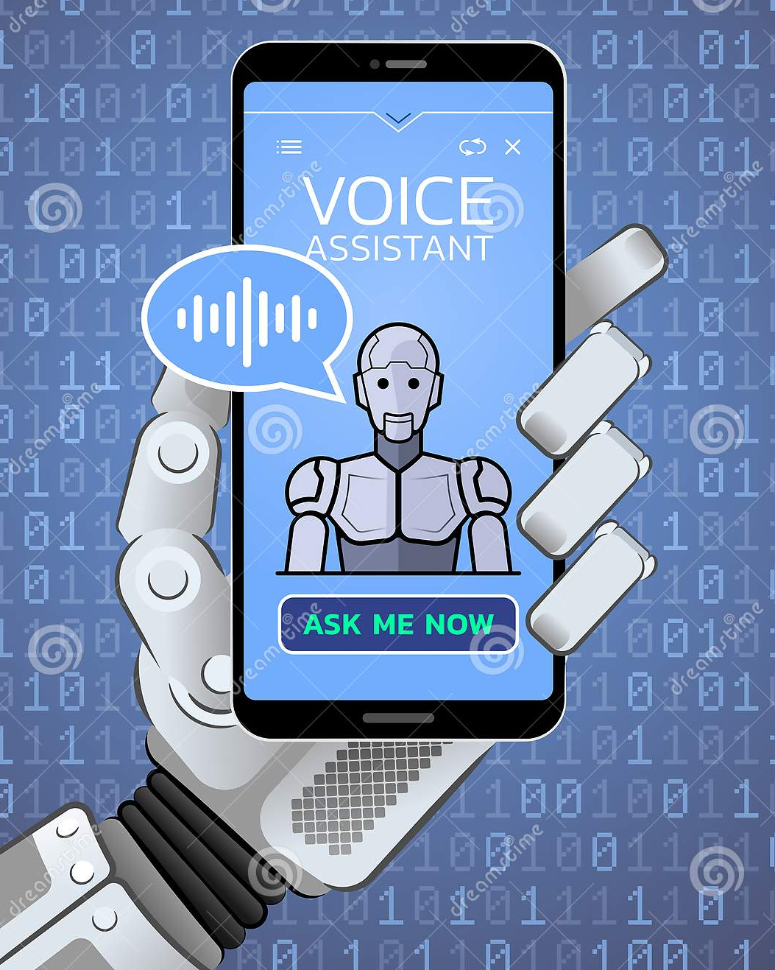
Using Python

Slide 2
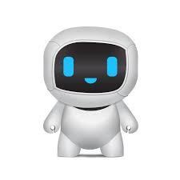
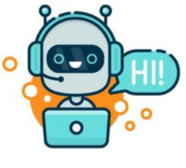

FINAL YEAR PROJECT PRESENTATION
ON
“VOICE ASSISTANT”
PRESENTED BY:-
DEV KRISHNA ROY ROLL NO.:- 193434-21-0004
MAYANK SHARMA ROLL NO.:- 193434-21-0003
UNIVERSITY OF CALCUTTA

Slide 3
Contents
Introduction
Tasks done by Voice Assistant?
How it works?
Data Flow Diagram (D.F.D)
Activity Diagram
Hardware & Software Requirements
Virtual Library Requirements
Advantages & Disadvantages
Future Plans & Scope of Voice Assistant
Conclusion

Slide 4
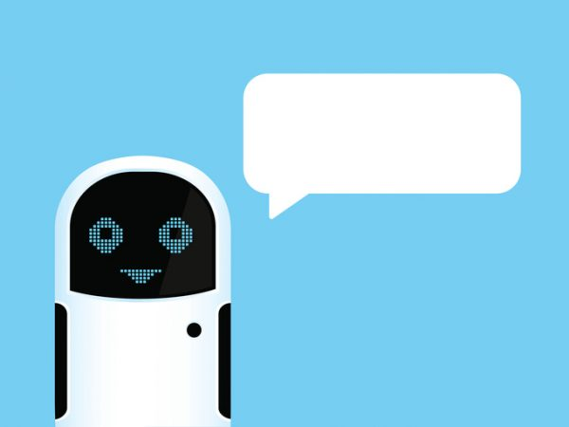

1. INTRODUCTION
Jennifer is a personal voice assistant technology based on Artificial Intelligence and can perform several tasks.
Jennifer is created by using Python. This software uses devices microphone to receive tasks and processing on it and sends response.
It is a combination of different modules and technologies.
Jennifer is created by using Python and importing various python modules like pyttsx3, pyjokes and pywhatkit
With the help of Jennifer the user can easily perform several tasks through our bot “Jennifer”.
Two gentlemen named Mayank and Dev Krishna created me
JENNIFER

Slide 5
2.
TASKS DONE BY VOICE ASSISTANT?
The Assistant will do several tasks :-
TASKS PERFORMED
TASKS PERFORMED
Introducing herself
Who created her?
Peform basic calculations
and integrations (Wolframalpha)
Google search and gathers Wikipedia information
Tells time. Capture images
Plays music from the computer library
Plays videos and music from Youtube
Also cracks joke which is imported from pyjokes

Slide 6

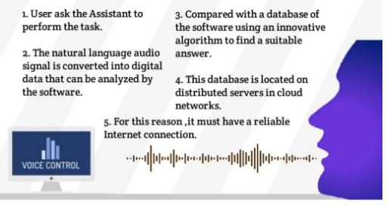
3. HOW IT WORKS?
User asks the assistant to perform the task.
The natural audio signal is converted to digital audio signal that can be analyzed by the software
Perform the tasks which was asked by the user accordingly.
Assistant looks for the data asked in different platforms like Google and Wikipedia
For this it must have a reliable and good internet connection
Once the data is retrived the Assistant uses its voice technology to produce the required output information to the user.

Slide 7
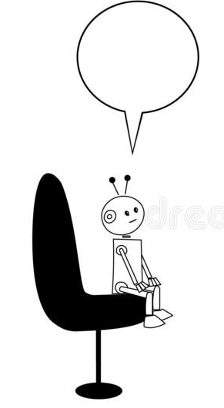
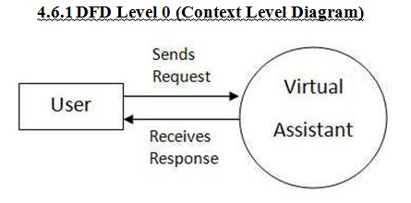
4.a. DATA FLOW DIAGRAM (D.F.D)
Level – 0 (Context Level Diagram)
DFD LEVEL 0
JENNIFER

Slide 8
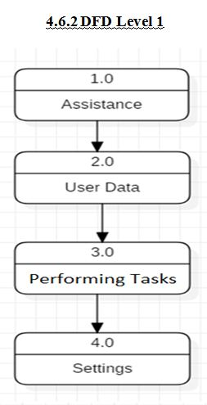
4.b. DATA FLOW DIAGRAM (D.F.D)
Level - 1
DFD LEVEL 1
JENNIFER

Slide 9
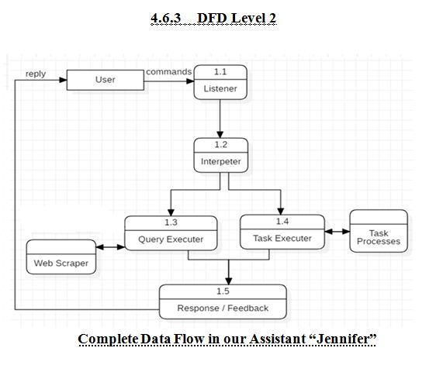
4.c. DATA FLOW DIAGRAM (D.F.D)
Level – 2
DFD LEVEL 2
JENNIFER

Slide 10
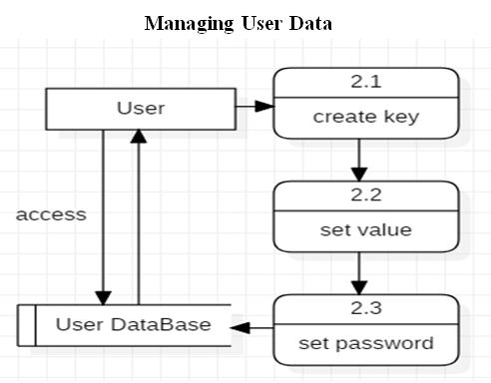
4.d. DATA FLOW DIAGRAM (D.F.D)
Level – 2 (Managing User data)
DFD LEVEL 2
JENNIFER

Slide 11
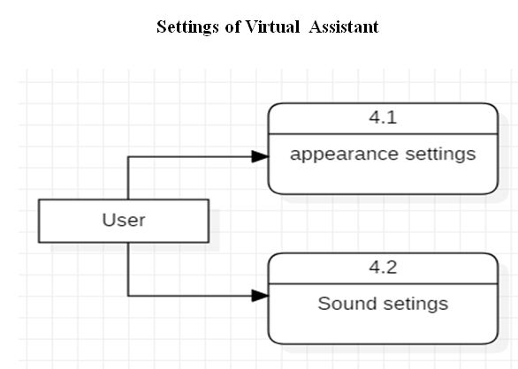
4.e. DATA FLOW DIAGRAM (D.F.D)
Level – 2 (Settings of Virtual Assistant)
DFD LEVEL 2
JENNIFER

Slide 12
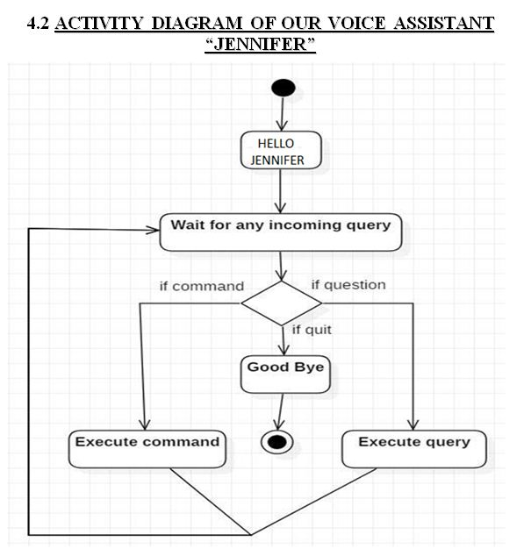
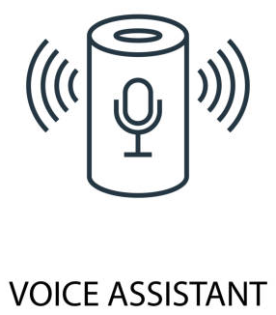
5. ACTIVITY DIAGRAM
“JENNIFER”

Slide 13
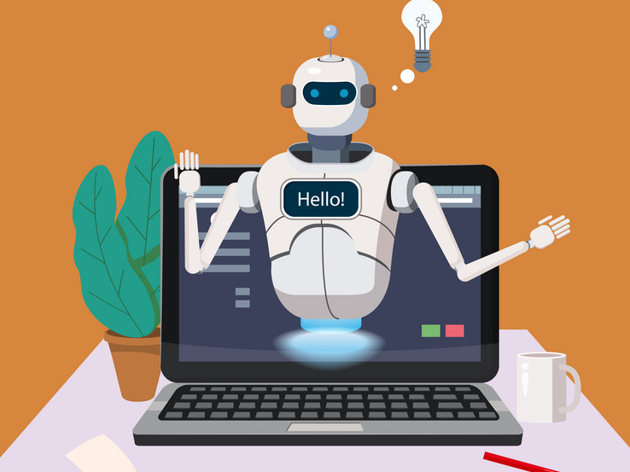
6. HARDWARE & SOFTWARE
REQUIREMENTS
HARDWARE: -
Pentium-pro processor or later.
RAM 512 MB or more.
SOFTWARE: -
Windows 7(32 bit) or above.
Python version 2.7 or later
VS Code editor

Slide 14
7. VIRTUAL LIBRARY REQUIREMENTS
1.) Speech Recognition Module
$ pip install SpeechRecognition
2.) Text to Speech Translation Library in Python
$ pip install pyttsx3
3.) Wikipedia
$ pip install Wikipedia
4.) Pyjokes Module
$ pip install pyjokes

Slide 15
8.a. ADVANTAGES OF VOICE ASSISTANT
ADVANTAGES:-
Voice based commands is much easier as compared to text based commands for older people to use as they are not comfortable in using keypad/keyboard.
Takes notes, searches anything in Google, listening to music, performing basic calculations and opening of YouTube are some of the tasks that can easily be performed by our voice assistant.
It takes low cost to operate and takes lesser time in writing texts.

Slide 16
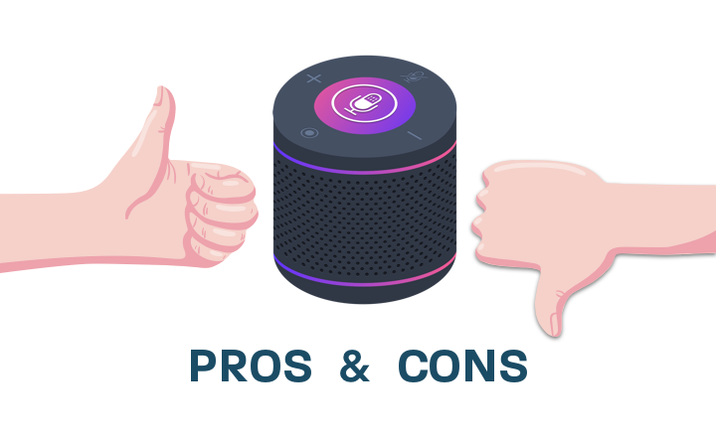
8.b. DISADVANTAGES OF VOICE ASSISTANT
DISADVANTAGES: -
It does not perform well in noisy places as it captures background sound.
User has to speak much louder and slower than normal speed so that the assistant understands it clearly and then perform the task.
Low accuracy is one of the disadvantages of the assistant.

Slide 17
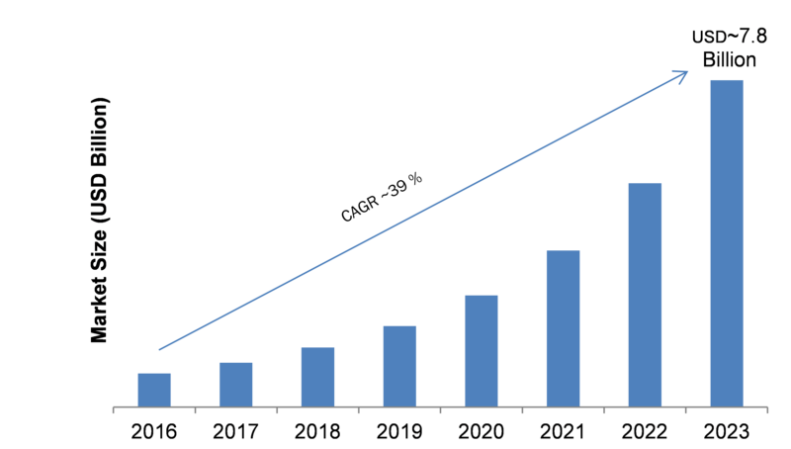
9. FUTURE PLANS & SCOPE OF VOICE ASSISTANT
FUTURE PLANS ARE:-
Visual Interface of Assistant
Face Recognition
Try to add more functionalities
Password Protection
Use of Voice Assistants
(2016-2023)
SCOPES ARE:-
Enhance the system of IoT
Senior citizens & Physically disabled People
Speak on Go: Explore world with your voice
Navigation

Slide 18
10. CONCLUSION
This presentation is the blue print of our Voice Assistant project “Jennifer” . In this presentation we discuss about what is voice assistant “Jennifer” and how it works.
With respect to less cost and less disadvantages, we can surely say that the system can have good future.
In today’s world, everything is happening at fast pace. AI are shaping the future of the world. As artificial intelligence is the future of the modern world we can conclude that voice assistants are indispensable in next 5 to 10 years.

Slide 19
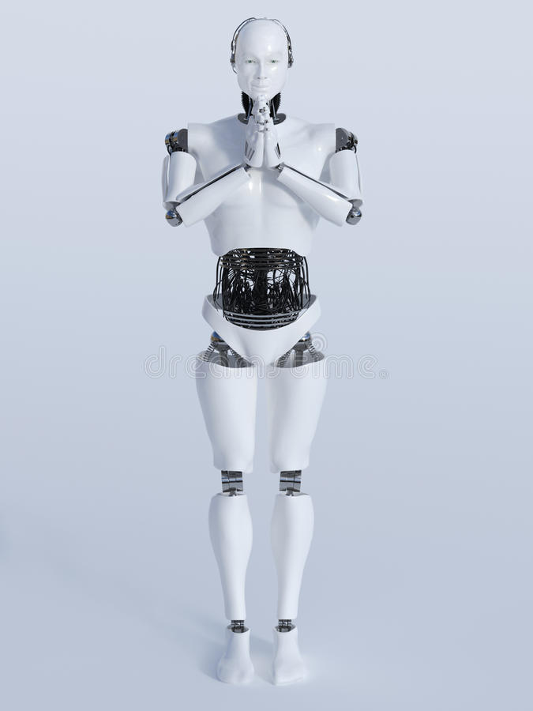

THANK
YOU!
PRESENTATION DONE BY:-
DEV KRISHNA ROY
ROLL NO. – 193434-21-0004
REG. NO. – 434-1111-0104-19
MAYANK SHARMA
ROLL NO. – 193434-21-0003
REG.NO.- 434-1111-0101-19

